Slide 1
Edwards
Benchmark Program
Transcatheter Valve Care Pathway

Slide 2
Content
Objectives, features and evolution
Clinical rationale to TAVI optimisation
Evidence and real-life experience
Program implementation
Evidence-based best practices and protocols
Criteria to success and program status
TAVI: transcatheter aortic valve implantation.

Slide 3
Objectives, features and evolution
Edwards Benchmark Program

Slide 4


Objectives
1. Improve quality and outcomes of TAVI programs
2. Optimise pathway with efficient use of resources
3. Increase hospital TAVI treatment capacity
4. Decrease burden of hospitalisation for patients
TAVI: transcatheter aortic valve implantation.
Edwards Benchmark Program

Slide 5






What is the Edwards Benchmark Program?
A global TAVI optimisation program developed for all stages of the clinical pathway: pre-, peri- and post-procedure
  Multidisciplinary
  Heart team approach
  10 evidence-based
  Best Practices
  to optimise pre-peri-post
  TAVI pathways
  Globally homogenous
  care pathway where protocols with
  local nuances are disseminated by European faculty
  Peer-to-peer learning
  with program faculty
  A living project
  responsive to latest
  learning and evidence
  A digital platform
  to facilitate program
  certification process
TAVI: transcatheter aortic valve implantation.

Slide 6



A complete pathway optimisation
Pre-procedure
Streamlined admission pathway and
tailored education
Peri-procedure
Optimised, foresighted practices for consistent safety outcomes and ease of future interventions
Post-procedure
Standardised protocols for a speedy post-procedural recovery and safe early discharge home

Slide 7




Program evolution
2019
2023
2021
30-day outcomes of BENCHMARK Registry presented at EuroPCR late-breaking clinical data session on 17th May³
    – BENCHMARK practices reduce mean hospital length of stay and average intensive care usage‡, without compromising patient safety
>85 European centres certified by the Edwards Benchmark program team
Results from 3M TAVR and
FAST-TAVI published^{1,2}
Edwards Benchmark program launches
in N. America and Europe, with
14 evidence-based Best Practices
Consecutive elective TF TAVI patient enrolment begins in the European BENCHMARK Registry
Global faculty begin to review Best Practices and protocols to reflect current guidelines and contemporary evidence
2022
2020
In October, pilot launch of the TAVI Nurse Leadership training in Europe with a curriculum designed by European TAVI Nurse and Coordinator faculty in association with Vancouver faculty
On 27 November, global faculty released evolution
of Edwards Benchmark program in Europe – now
with 10 evidence-based Best Practices
Edwards Benchmark program extends support to TAVI community amid COVID-19 pandemic with remote peer-to-peer education and launch of the digital platform
‡Combined coronary care unit/intensive care inut/intermediate care unit time
COVID-19: coronavirus disease 19; N. America: North America; TAVI: transcatheter aortic valve implantation; TF: transfemoral.
1. Barbanti M et al. EuroIntervention. 2019; 15: 147–54; 2. Wood DA et al. JACC Cardiovasc Interv. 2019; 12: 459–69.
3. Frank D et al. EuroPCR 16–19 May 2023

Slide 8
Clinical rationale to TAVI optimisation
Edwards Benchmark Program

Slide 9
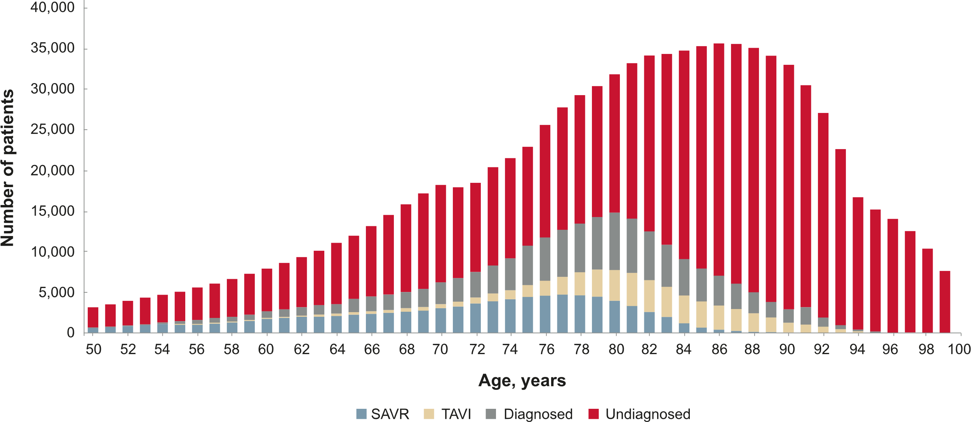
Most cases of severe symptomatic aortic stenosis remain undiagnosed and untreated
Severe symptomatic aortic stenosis by age in the EU (estimated)¹
EU: European Union; SAVR: surgical aortic valve replacement; TAVI: transcatheter aortic valve implantation.
1. Thoenes M et al. J Thorac Dis. 2018; 10: 5584–94.

Slide 10
Greater TAVI access can improve prognosis and survival rates in otherwise untreated severe aortic stenosis
`
3.4%
2–3^{yrs}
67%
Of people aged ≥75 years have severe aortic stenosis¹
Typical survival after diagnosis, without treatment^{2*}
Mortality rate after
5 years untreated³
Greater access to TAVI correlates with improved survival rates⁴
*Severe symptomatic aortic stenosis
TAVI: transcatheter aortic valve implantation; yrs: years.
1. Osnabrugge RLJ et al. J Am Coll Cardiol. 2013; 62: 1002–12; 2. Badran AA et al. Ann R Coll Surg Engl. 2012; 94: 416–21;
3. Strange G et al. J Am Coll Cardiol. 2019; 74: 1851–63; 4. Hartley A et al. Front Cardiovasc Med. 2021; 8: 748137.
Notes:
Slide title: Strange 2019 B
Prevalence: Osnabrugge 2013 A–C
5-year mortality: Strange 2019 A
Survival after diagnosis: Badran 2012: A
Mortality from severe AS is declining (…): Hartley 2021 A

Slide 11






In Europe, rising demand for TAVI is currently putting pressure on hospitals to increase capacity within their available resources
Increased ageing demographic^{1,2}
COVID-19-related delays¹
Staff shortages increase waiting times for elective surgery³
Increasing demand
for TAVI¹
More patient access required without concomitant
growth of hospital resources¹
Broader guideline recommendations²
Class 1a recommendation
Patients who are aged
≥75 years²
Class 1a recommendation
Patients of any age who are high risk/unsuitable
for surgery²
  TAVI: transcatheter aortic valve implantation.
  1. MacCarthy P et al. Br J Cardiol. 2021; 28: 70–2; 2. Vahanian A et al. Eur Heart J. 2021; doi:10.1093/eurheartj/ehab395;
  3. OECD/European Union. Health at a glance: Europe 2020: State of health in the EU cycle. 2020.
Notes:
Patients aged ≥75 years (…): Vahanian 2021 B

Slide 12


Broader guidelines recognise the excellent effectiveness and safety outcomes of TAVI for many patients
TAVI recommendations¹
Patients aged ≥75 years
Level 1a
or
Patients who are high risk
(risk score >8%)
Level 1a
Most patients who undergo TAVI recover quickly after a short hospital stay and rapidly return to normal activities¹
or
All high-risk patients (risk score >8%)
Patients unsuitable for SAVR
Level 1a
  SAVR: surgical aortic valve replacement; TAVI: transcatheter aortic valve implantation.
  1. Vahanian A et al. Eur Heart J. 2021; doi:10.1093/eurheartj/ehab395.

Slide 13





COVID-19 pandemic highlighted advantages of an optimised TAVI pathway in clinical practice
Benefits of TAVI
Continued treatment needed for severe aortic stenosis due to high risk of mortality¹
Possibility for
streamlined work-up¹
Mechanical ventilation
not routinely needed¹
Intensive care
not routinely needed¹
Diversion of patients accepted for SAVR to TAVI¹
Minimised impact on hospital resources and capacity¹
Shorter
hospitalisation time²
Reduced exposure
to COVID²
A streamlined TAVI pathway is encouraged during the pandemic¹
SAVR: surgical aortic valve replacement; TAVI: transcatheter aortic valve implantation.
1. Khialani B, MacCarthy P. Heart. 2020; 106: 1183–90; 2. Sundt T. JAMA Netw Open. 2020; 3: e2020368.
Notes:
Mechanical ventilation/ICU access not needed: Khialani 2020 A
^{Diversion: Khialani 2020 B}
Continued treatment: Khialani 2020 C

Slide 14
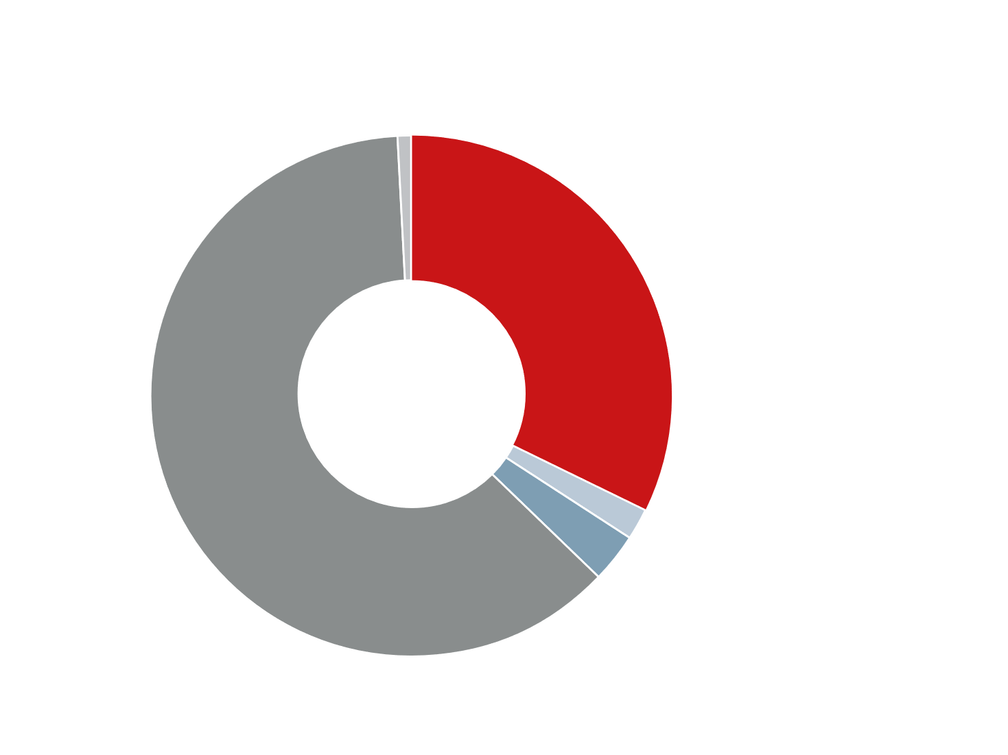
Many patients remain hospitalised after TAVI without reason, which can negatively impact patients’ health
Reasons for prolonged (>3 days) hospital stay after TAVI¹
3–5/1000
Bed days
>30%
1% Logistics
Hospitalisation-associated disability^{3*}
Hospital fall rate²
62%
Complications
32%
No reason
6%
Increased risk of pneumonia for every day spent in hospital⁴
Increased risk of DVT with
older age and immobility⁵
2% Discharge refusal
3% Loss of autonomy
*Defined as the loss of ability to perform one or more activities of daily living. TAVI: transcatheter aortic valve implantation; DVT: deep vein thrombosis
1. Durand E et al. Arch Cardiovasc Dis. 2020; 113: 391–400. 2. Agency for Healthcare Research and Quality. Falls. https://psnet.ahrq.gov/primer/falls [accessed 15 December 2021]; 3. Reichardt LA et al. BMC Geriatrics. 2016; 16: 59; 4. Wϋrschinger F et al. PLoS One. 2018; 13: e0193558; 5. Amin K, Guyler P. Deep vein thrombosis in older hospitalised inpatients. https://www.gmjournal.co.uk/dvt-thromboprophylaxis [accessed 19 January 2022].

Slide 15

TAVI has greatly evolved in the last decade towards a safer and faster procedure
Conventional TAVI
Streamlined TAVI*
Patient population
Inoperable or high risk¹
Age ≥75 years or high risk or unsuitable for surgery²
Anaesthesia³
General
Local
Echocardiography³
Transoesophageal
Transthoracic
Venous access³
Central
Central or peripheral
Sheath diameter
22 F⁴
14–16 F⁵
Urinary catheter³
Standard
Avoidance
Critical care LOS³
24–48 hours
<24 hours
Target LOS (days)⁶
6 days
1 day
*Increased operator experience is another contributing factor to a lower risk of current versus historical TAVI procedures.
LOS: length of stay; TAVI: transcatheter aortic valve implantation.
1. Vahanian A et al. Eur Heart J. 2012; 33: 2451–96; 2. Vahanian A et al. Eur Heart J. 2021; doi:10.1093/eurheartj/ehab395;
3. Lauck SB et al. Circ Cardiovasc Qual Outcomes. 2016; 9: 312-21. 4. Nascimbene A et al. Tex Heart Inst J. 2015; 42: 144–7;
5. Akodad M, Lefèvre T. Front Cardiovasc Med. 2018; 5: 96; 6. Wood DA et al. JACC Cardiovasc Interv. 2019; 12: 459–69.

Slide 16



Published evidence and real-life experience
Edwards Benchmark Program

Slide 17

The impact of the Edwards Benchmark Program is proven by clinical evidence from the 3M TAVR and FAST TAVI trials
  Standardises the TAVI care pathway to improve safety and efficacy outcomes¹
  Helps patients recover
  faster through earlier discharge home¹
  Improves quality of life across physical and mental health²
  Conserves healthcare resources³ and identifies pathway efficiencies to enable multidisciplinary Heart Teams to treat more patients
TAVI: transcatheter aortic valve implantation.
1. Wood DA et al. JACC Cardiovasc Interv. 2019; 12: 459–69;
2. Lauck SB et al. Cardiovasc Revasc Med. 2020; 21: 1573–8;
3. Butala N. Economics of Minimalist TAVR: Results From the 3M-TAVR Economic Study, presented at TVT 2021.

Slide 18





Published evidence from 3M TAVR and FAST TAVI trials
Excellent safety outcomes
enabling earlier discharge
QoL improvements
that are immediate and sustained
Increased access to care
by preserving hospital resources
30 days post procedure:
Change in KCCQ-OS score
in Year 1 post procedure:⁴*
Savings with streamlined
vs conventional TAVI1:^{5†}
1%
1%
1.5%
Mortality¹
Stroke¹
Major
vascular complications²
Points vs baseline
11%
Lower 30-day
follow-up costs‡§
4%
1 year:
+26.6
CV readmissions¹
+1.9 points
p=0.08
6%
PPM implantation³
30 days:
+24.7
19%
+3.4 points
p<0.001
+21.3
Savings in 30-day costs§¶
80%
Next-day discharge home³
2 weeks:
+21.3 points
p<0.001
Baseline
Enabling faster recovery
and mobilisation^{1,3}
Improvements in both physical
and mental health⁴
Allowing hospitals to provide more patients with high-quality care
*Good outcome defined as being ‘alive and well’ with a KCCQ-OS score ≥60 points and with no decrease from baseline of ≥10 points; †Driven by lower costs for index procedure and reduced hospitalisation and physician fees (including anaesthesiology); ‡ Driven by lower hospitalisation rates, and in- and outpatient costs; §In intermediate-risk patients; ¶Statistically significant reduction.
CV: cardiovascular; KCCQ-OS: Kansas City Cardiomyopathy Questionnaire overall summary; PPM: permanent pacemaker; QoL: quality of life; TAVI: transcatheter aortic valve implantation.
1. Barbanti M et al. EuroIntervention. 2019; 15: 147–54; 2. Lauck SB et al. Circ Cardiovasc Qual Outcomes. 2016; 9: 312–21; 3. Wood DA et al. JACC Cardiovasc Interv. 2019; 12: 459–6; 4. Lauck SB et al. Cardiovasc Revasc Med. 2020; 21: 1573–8; 5. Butala N. Economics of Minimalist TAVR: Results From the 3M-TAVR Economic Study, presented at TVT 2021.
Notes:
Change from baseline in
KCCQ-OS score throughout Year 1 post procedure:
Lauck 2020: p3A

Slide 19




Real-life experience in European hospitals before and after Edwards Benchmark program implementation
Time to mobilisation
(hours)
Length of
stay (days)
Patients undergoing TAVI
Before
After
Before
After
Before
After
Hospital Universitario Virgen Del Rocio
Seville, Spain
2
(60%)
24
6
5–6
3
(30%)
2
/week
4
/week
3+
(10%)
Hospital Giuseppe Mazzini
Teramo, Italy
2
(25%)
>24
5
7–10
3
(55%)
n/a
(20%)
3+
Freeman Hospital
Newcastle upon Tyne, United Kingdom
Median:
n/a
≤4
2
1
3–4
/day
4–5
/day
Tours Regional and University Hospital
France
2
(65%)
9-12
/week
about 25% increase
n/a
4-6
5–6
3
(20%)
n/a
(1%)
4+
n/a: not available; TAVI: transcatheter aortic valve implantation.
Self-reported data by the hospitals.
Notes:
Hospital Universitario (…): Success story Seville
Time to mobilisation: 4A
LOS: 4B
Patients undergoing TAVI: 5A
Hospital Giuseppe (…): Success story Teramo
Time to mobilisation: 4A
LOS: 4B

Slide 20
BENCHMARK Registry
Setting a benchmark for resource utilisation and quality of care in
patients undergoing TF TAVI in Europe
A multicentre, international, non-interventional registry in patients with severe aortic stenosis undergoing TF TAVI¹
Assessing the impact of implementing BENCHMARK Practices)¹
Phase
1
Before BENCHMARK
Evaluation of patient outcomes, safety and
resource utilisation before implementation
of BENCHMARK Practices
2
Education phase
Hospital self-assessment and education
on BENCHMARK Practices
7
28
2,400
European countries
3
Implementation phase
Incorporating BENCHMARK Practices into hospital routine
centres
TAVI patients target enrolment
2023
2024
4
After BENCHMARK
Evaluating the impact of implemented BENCHMARK Practices on patient outcomes, safety and resource utilisation
First European BENCHMARK Registry outcomes
target
completion date
TAVI: transcatheter aortic valve implantation; TF: transfemoral.
1. McCalmont G et al. Clin Cardiol. 2021; 44: 1344–53.

Slide 21
BENCHMARK Registry study design
Before implementing BENCHMARK Practices
Consecutive patients with severe symptomatic AS over 18 years of age undergoing transfemoral TAVI (n=898)*
30-day and 12-month follow-up
Primary endpoints
Length of hospital stay (overall: door to TAVI, TAVI to door)
Time spent in the ICU, CCU and IMC and prioritisation of a rapid return to a general ward
Secondary endpoints
Procedural and 30-day safety of BENCHMARK Practices
Implementation success of BENCHMARK Practices
Patient satisfaction
28 sites in 7 countries,
2405 patients: France, Germany, Austria, Italy, Spain, Czech Republic, Romania
BENCHMARK Practices
Training and implementing the 8 BENCHMARK Practices at these sites
After implementing BENCHMARK Practices
Consecutive patients with severe symptomatic AS over 18 years of age undergoing transfemoral TAVI (n=1,507)*
30-day and 12-month follow-up
*Target recruitment was 900 patients before implementation of BENCHMARK Practices and 1,500 patients after implementation of BENCHMARK Practices
AS: aortic stenosis; CCU: coronary care unit; ICU: intensive care unit; IMC: intermediate care unit; TAVI: transcatheter aortic valve implantation
Frank D et al. EuroPCR 16–19 May 2023, Paris

Slide 22
The 8 pre-defined BENCHMARK best practices
1
2
3
4
Education of
patient and family
Education and alignment of the internal team
Determination of anticipated discharge date at admission based on pre-procedural
risk stratification
Echo- or
angiographic check at end of procedure is performed to confirm proper closing
of access site/proper management
of complication
5
6
7
8
Early mobilisation
of the patient
Decision tree
used to determine
the need for new PPM
Daily visit to patient
by implanter and interaction with rest of the team
Criteria-based discharge
PPM: permanent pacemaker
1. McCalmont G et al. Clin Cardiol. 2021; 44: 1344–53.

Slide 23

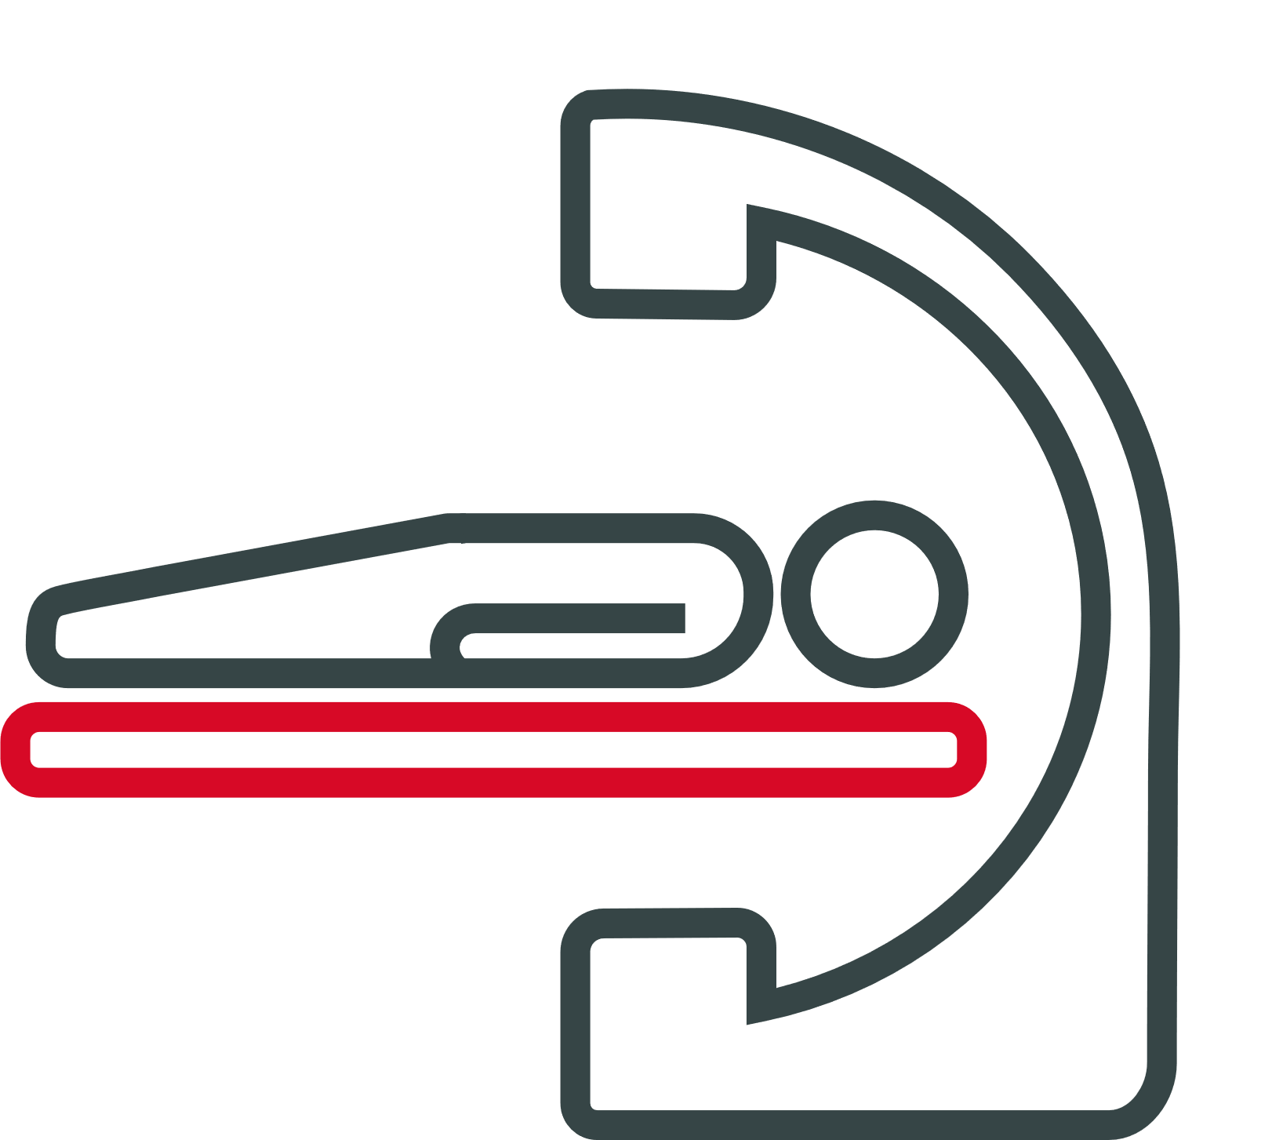


BENCHMARK Registry 30-day results: Primary endpoints
Hospital length of stay
Intensive care usage
Combined mean time in ICU/CCU/IMC reduced by more than 14 hours from 1.9 days to 1.3 days after implementing BENCHMARK Practices
Mean hospital length of stay reduced by 2 days (0.6 days before and 1.4 days after) after implementing BENCHMARK Practices
Before BENCHMARK
Before BENCHMARK After BENCHMARK
2.5 days
5.3 days
1.9 days
1.3 days
Admission
TAVI procedure
Discharge
Total length of stay: 7.8 days
After BENCHMARK
1.9 days
3.9 days
Admission
TAVI procedure
Discharge
Total length of stay: 5.8 days
Median (IQR): 6 days (4, 9 days) before BENCHMARK;
4 days (3, 7 days) after BENCHMARK
CCU: coronary care unit; ICU: intensive care unit; IMC: intermediate care unit; IQR: interquartile range; TAVI: transcatheter aortic valve implantation
Frank D et al. EuroPCR 16–19 May 2023, Paris

Slide 24







BENCHMARK Registry 30-day results: Secondary endpoints
Local anaesthesia with or without conscious sedation
Patient safety
Patient safety at discharge and at 30-day follow-up was uncompromised after implementing BENCHMARK Practices
Before BENCHMARK After BENCHMARK
p<0.001
84.5%
96.1%
Significant reductions in mean (±SD) intervention time
Procedure time
Overall intervention time
Before BENCHMARK After BENCHMARK
No change in
all-cause mortality
No change in rehospitalisation rate
(valve-related or worsening chronic heart failure)
No change in incidence of stroke
66 ± 35
minutes
p<0.001
55 ± 31
minutes
Patient satisfaction
Over 90% of patients were satisfied/very satisfied across
all aspects of their TAVI experience after implementing BENCHMARK Practices*
Before BENCHMARK After BENCHMARK
97 ± 43
minutes
p<0.001
89 ± 40
minutes
*Patient satisfaction survey included: pre-TAVI discussions, active participation in discussions affecting their healthcare, interactions with care team, involvement of family and preparations for discharge
TAVI: transcatheter aortic valve implantation
Frank D et al. EuroPCR 16–19 May 2023, Paris

Slide 25



BENCHMARK Registry 30-day results: Key messages
Implementing BENCHMARK Practices in pre-, peri- and post- TAVI procedural pathways:
Results in reduced hospital length of
stay, including in
high-care facilities
Unlocks hospital efficiency with uncompromised safety for patients
Brings high level of
patient satisfaction and generates opportunities
for increased capacity
12 months data and outcomes to follow

Slide 26
Program implementation and next steps
Edwards Benchmark Program

Slide 27
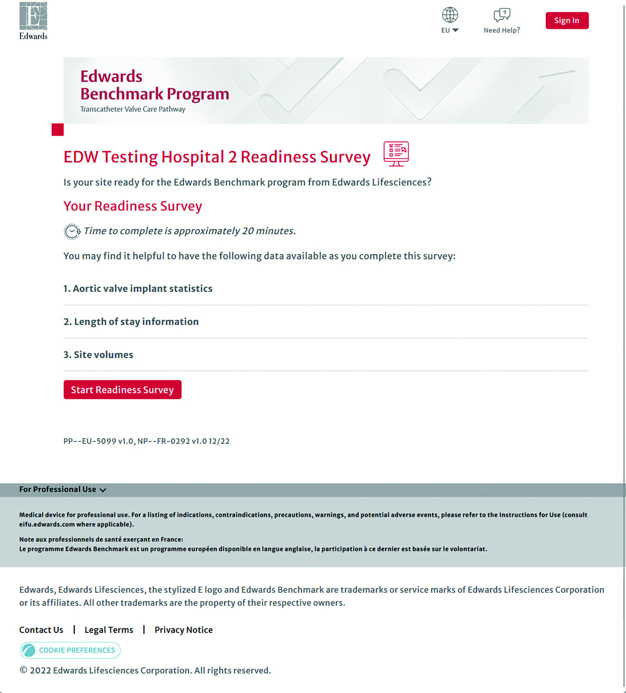

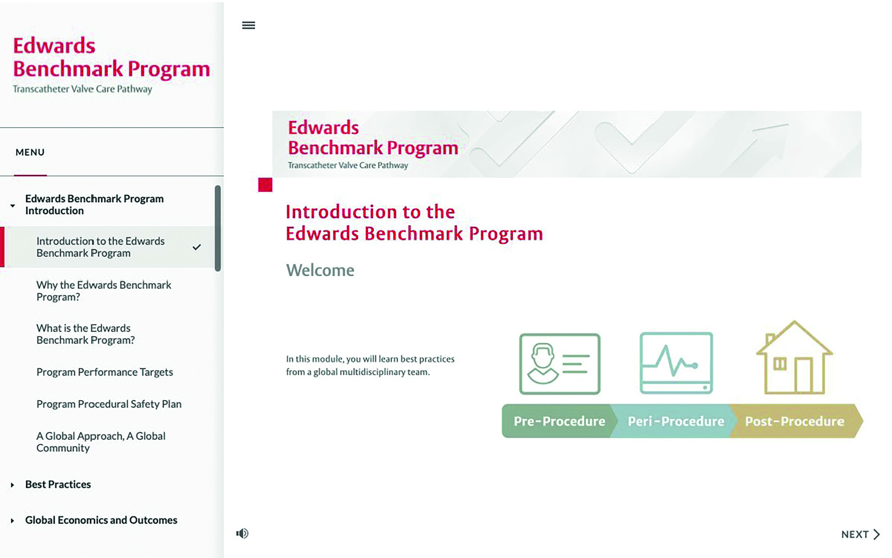
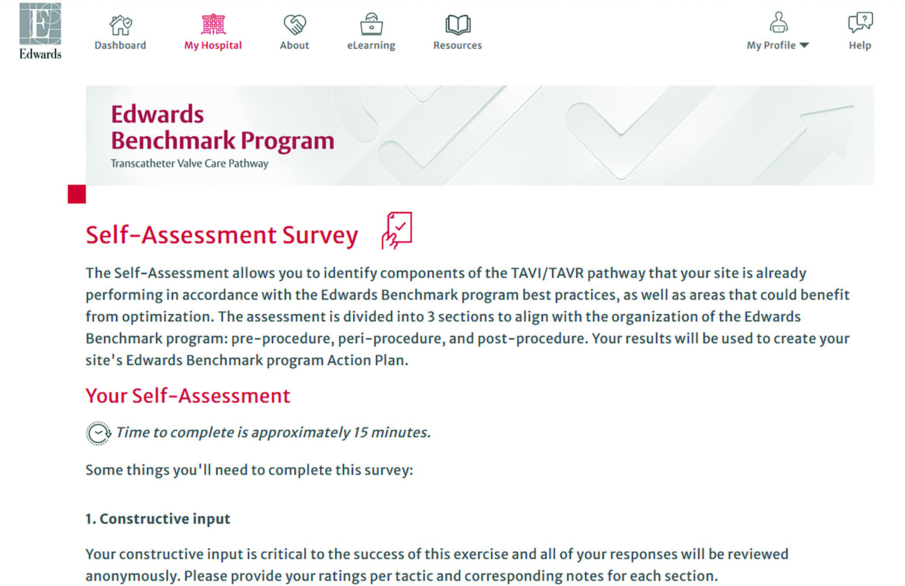

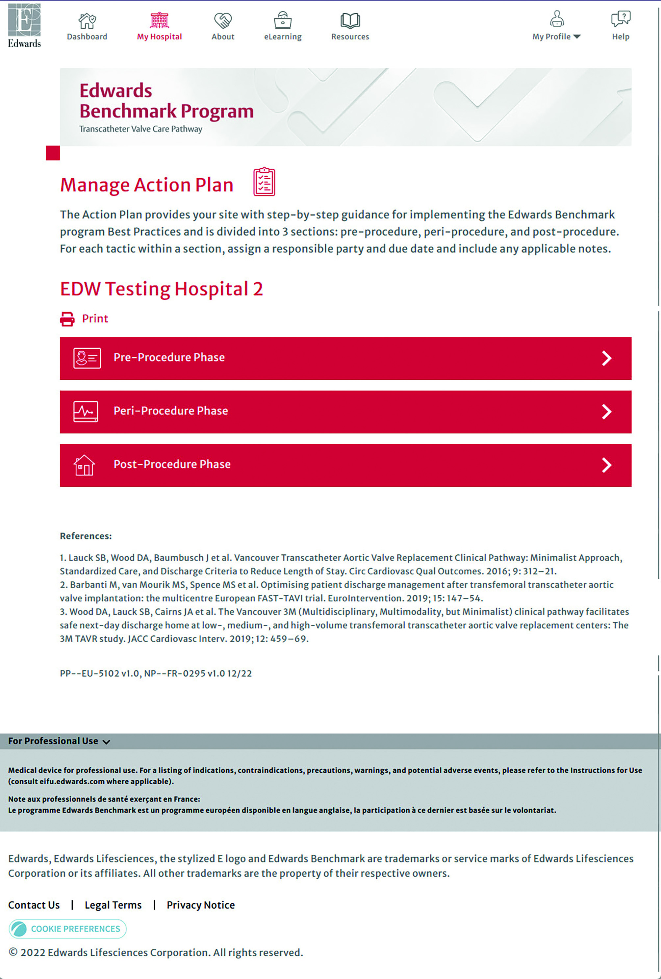
A peer-to-peer learning program focusing on evaluation, education and engagement
Digital platform
  Assess program and
  create action plan
2
  Partner with clinical experts throughout implementation
1
  Implement best practices
3
eLearning modules
Edwards Benchmark program faculty
Readiness survey
Self-assessments
1
Literature compendium
2
Admin compendium
Action plan
3
Safety checklist
4
Clinical protocols
Edwards Benchmark Program

Slide 28


Edwards Benchmark Program workflow
Program planning
Implementation (estimated 3 months)
Pitching
Overview of the program and
complete readiness survey
Heart Team meeting
and complete
self-assessment survey
Exchange with faculty
and finalise action plan
Check-in visits and
optional proctoring
Completion
Edwards Benchmark program
team and hospital champion(s)
discuss the program. Edwards Benchmark program leader completes readiness survey
Heart Team meeting
to present the Edwards Benchmark program. Anonymous
self-assessment survey is completed by multi-disciplinary team
eLearning will be available
on the digital platform.
Self-assessment results are reviewed with expert faculty and the multi-disciplinary team creates a roadmap for best practices implementation
Monthly check-ins with multi-disciplinary team and expert faculty. Engage in-person with expert faculty if additional education is required

Slide 29









The Faculty Team: Our partners to roll-out the program
European Faculty
~30 centres
Approx. 1 European faculty centre for 3 active centres
Vancouver Faculty
Proctoring
Specific expertise
Ad-boards/steering committee
UK and Northern Ireland
Middlesbrough: D Muir and P Williams
Belfast: M Spence and F Kelly
Birmingham: S Doshi and E Lawton
London: M Ozkor, K Opada and S Giannaris
Nordics
Helsinki: T Vähäsilta
Oslo: K Russel
Germany
Kiel: D Frank, S Wundram and J Dümmler
Frankfurt: K Zacharowski
Bonn: R Bailon
Berlin: H Dreger
Heidelberg: F Leuschner
Hannover: T Kempf and C Napp
The Netherlands
Rotterdam: M de Ronde
France
Rouen: E Durand
Bordeaux: F Cassasus and O Darremont
Lyon: l Sanchez
Tours: C Saint Etienne
Besançon: N Meneveau
Marseille: T Cuisset
Eastern Europe
Prague (CZ): J Malý and M Želísko
Italy
Massa: S Berti
Bologna: F Saia
Avellino: E Di Lorenzo and B Cefalo
Palermo: C Gandolfo
Iberia
Barcelona: B Garcia Blanco
Malaga: C Urbano and B Chamorro
Switzerland
Zurich: M Taramasso
TAVI: transcatheter aortic valve implantation.

Slide 30
Evidence-based best practices and protocols
Edwards Benchmark Program

Slide 31
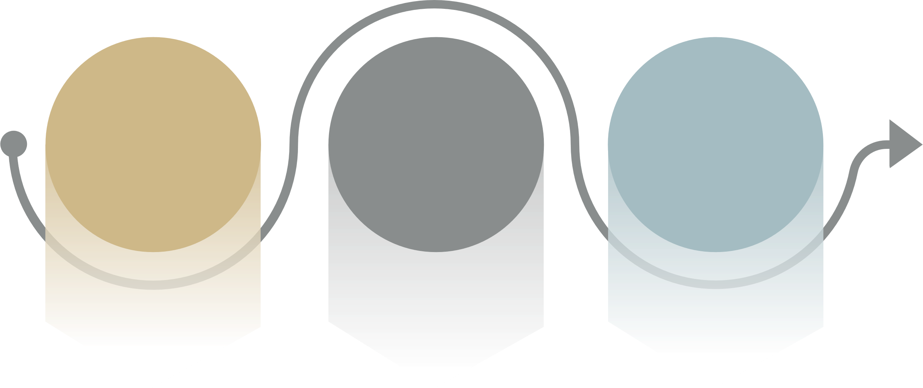
Implementation of best practices at every step of the patient care pathway
Pre-procedure
Streamlined admission pathway and tailored education
Peri-procedure
Optimised, foresighted practices for consistent safety outcomes
and ease of future interventions
Post-procedure
Standardised protocols for a speedy post-procedural recovery and ongoing patient care
Multidisciplinary Heart Team involvement in patient care
Standardised screening, assessment and admission
Tailored education for patients and shared decision-making
Consistent clinical outcomes with appropriate patient safety targets
Optimised approach to minimalist peri-procedural steps
Streamlined procedure matched to patients’ lifetime disease management
Standardised post-procedural care
Consistent management of new conduction delays
Safe and timely discharge home
Regular communication between Heart Teams and referring network

Slide 32
The 10 evidence-based TAVI best practices
(released in Europe in November 2022)
Pre-procedure
Peri-procedure
Post-procedure
1
Multidisciplinary Heart Team involved in patient care who attend regular meetings
Standardised screening, assessment and admission pathway
Tailored education for patients, and families, that includes shared decision-making and discussion of post-procedure discharge plan
4
Consistent clinical outcomes with appropriate patient safety targets*
Optimised peri-procedure practices (including anaesthesia, staffing and resources)
Procedure planning that incorporates lifetime disease management and facilitates future THV-in-THV and coronary interventions
7
Standardised post-procedure care to facilitate nurse-led safe recovery and early mobilisation
Consistent management of conduction delays
Safe and timely discharge home
Regular communication with referring physicians and program administration
5
2
8
3
6
9
10
Best practice 6 and 10 were added to reflect contemporary evidence and guidelines and incorporate lessons learned by the faculty and the global clinical community
*Death, stroke, vascular complications, LOS, PPM
and 30-day cardiovascular readmissions
LOS: length of stay; PPM: permanent pacemaker;
TAVI: transcatheter aortic valve implantation; THV: transcatheter heart valve.
Edwards Benchmark Program

Slide 33
Procedure planning that looks ahead
Best practice 6: Procedure planning that incorporates lifetime disease management and facilitates future
THV-in-THV and coronary interventions
TAVI is now available to younger patients with longer life expectancy^{1,2}
Most patients will out live
their bioprosthesis¹
High likelihood of future
cardiac interventions^{2,3}
Valve replacement
may be needed eventually due to SVD^{1,4}
Lifetime strategy
for disease management needed¹
Coronary access
should be maintained^{3,4}
Pre-procedural considerations:
Suitability of valve type and size
for valve-in-valve TAVI^{5–7}
Valve placement^{4,6,7}
Pre-procedural considerations:
Valve type and size, also taking into
account the patient’s anatomic features^{2–4}
Valve placement/alignment^{2–4}
SVD: structural valve deterioration; TAVI: transcatheter aortic valve implantation.
1. Tarantini G. JACC Cardiovasc Interv. 2021; 14: 1727–30; 2. Tarantini G et al. Circ Cardiovasc Interv. 2022; 15: e011045;
3. Brabanti M et al. JACC Cardiovasc Interv. 2020; 13: 2543–55. 4. Yerasi C et al JACC Cardiovasc Interv. 2021; 14: 1169–80;
5. Vahanian A et al. Eur Heart J. 2021; doi:10.1093/eurheartj/ehab395; 6. Akodad M et al. Cardiovasc Eng Technol. 2022.
doi: 10.1007/s13239-022-00627-1; 7. Sathananthan J et al. EuroIntervention. 2021; 17: 856–6.
Notes:
TAVI available to younger patients (…):
Tarantini 2021: 1A
Tarantini 2022: 1A
Lifetime strategy needed:
Tarantini 2021: 1A
Outlive their bioprosthesis:
Tarantini 2021: 1B
Likelihood of future cardiac interventions:
Brabanti 2020 JACC: 2A, 2B
Tarantini 2022: 7A
Valve replacement due to SVD:
Tarantini 2021: 1C
Yerasi 2021: 1A
Suitability of valve type and size:
Vahanian 2021: 27A
Akodad 2022: 1A
Sathahananthan 2022: 1A, 1B
Valve placement (for valve replacement part):
Akodad 2022: 1B
Sathahananthan 2022: 1A, 1C
Yerasi 2021: 6A
Coronary access:
Brabanti 2020 JACC: 7C, 11A
Yerasi 2021: 4A
Valve type and size:
Tarantini 2022: 10A, 11A
Brabanti 2020 JACC: 8A, 8B, 9A, 11B
Yerasi 2021: 53A
Valve placement/alignment:
Yerasi 2021: 3A, 5A
Tarantini 2022: 10A, 10B, 10C
Brabanti 2020 JACC: 8C, 9A, 9B

Slide 34




A focus on promoting care networks and interdisciplinary communication to achieve the best possible outcomes
Best practice 10: Regular communication with referring physicians and program administration
TAVI-related complications
that require specialist care^{2,3}
Potential requirement of valve
replacement due to durability limitations^{2,4}
(especially younger patients)⁴
Integration and coordination
of post-TAVI medical care is essential to achieve the best possible outcomes⁵
Current guidelines highlight
the role of Heart Valve Centres
in promoting networks
that also include referring cardiologists and
primary physicians⁶
Periodic monitoring and
reassessment needed⁵
SVD: structural valve deterioration; TAVI: transcatheter aortic valve implantation.
1. Virgili G et al. Medicina (Kaunas). 2021; 57: 883; 2. Aranzulla TZ et al. E-journal of Cardiol. Prac. 2016. 14;
3. Yerasi C et al JACC Cardiovasc Interv. 2021; 14: 1169–80; 4. Otto CM et al. J Am Coll Cardiol. 2017; 69: 1313–46;
5. Vahanian A et al. Eur Heart J. 2021; doi:10.1093/eurheartj/ehab395.
Notes:
Post-TAVI readmission:
Patel 2022: 3A
TAVI-related complications:
Virgil 2021: 2A, 5A
Aranzulla 2016: 7A
New valve required:
Virgil 2021: 4A
Yerasi 2021: 1A, 2A
Monitoring needed:
Virgil 2021: 5A
Integration of care:
Otto 2017: 24A
Role of Heart Valve Centres:
Vahanian 2021: 13A
Periodic monitoring:
Otto 2017: 25A

Slide 35
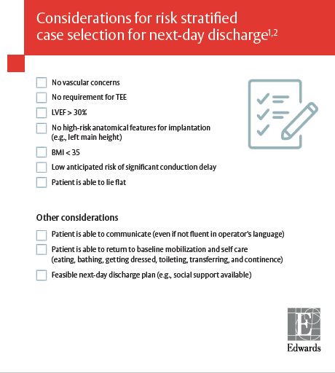
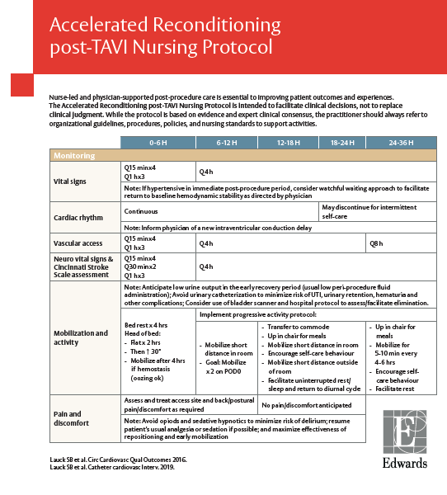

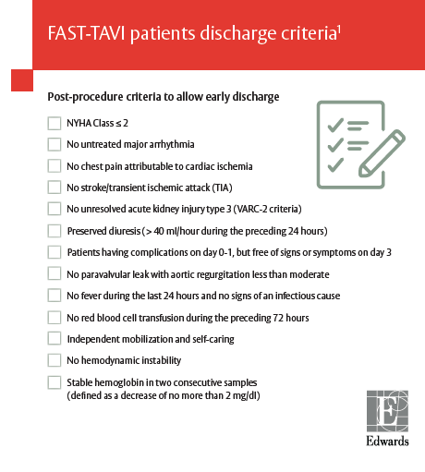
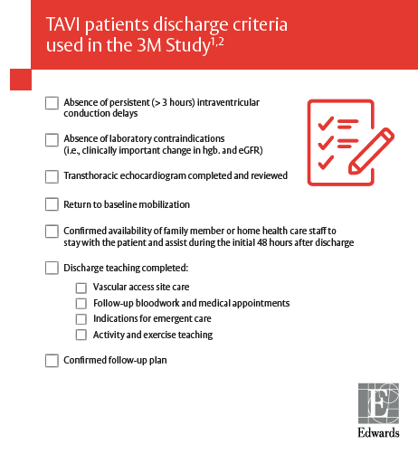
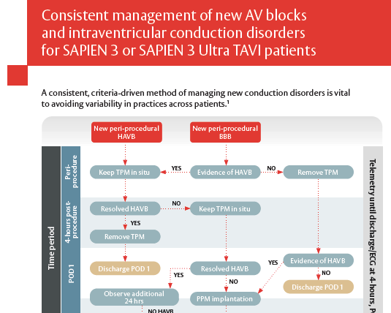
Evidence-based protocols designed to support pre-, peri-, and post-TAVI care at certified centres
Developed from clinical
expert consensus and published protocols
that are based on evidence
from the FAST-TAVI, 3M TAVR, and Vancouver 3M studies^{1–4}
Designed to guide
clinical decisions
while always giving way
to the practitioner's judgement
and local guidelines, procedures, policies and standards
AV: atrioventricular; TAVI: transcatheter aortic valve implantation.
1. Barbanti M et al. EuroIntervention. 2019; 15: 147–54; 2. Lauck SB et al. Circ Cardiovasc Qual Outcomes. 2016; 9: 312–21;
3. Lauck SB et al. Catheter Cardiovasc Interv. 2020; 96: 450–8; 4. Wood DA et al. JACC Cardiovasc Interv. 2019; 12: 459–6.

Slide 36
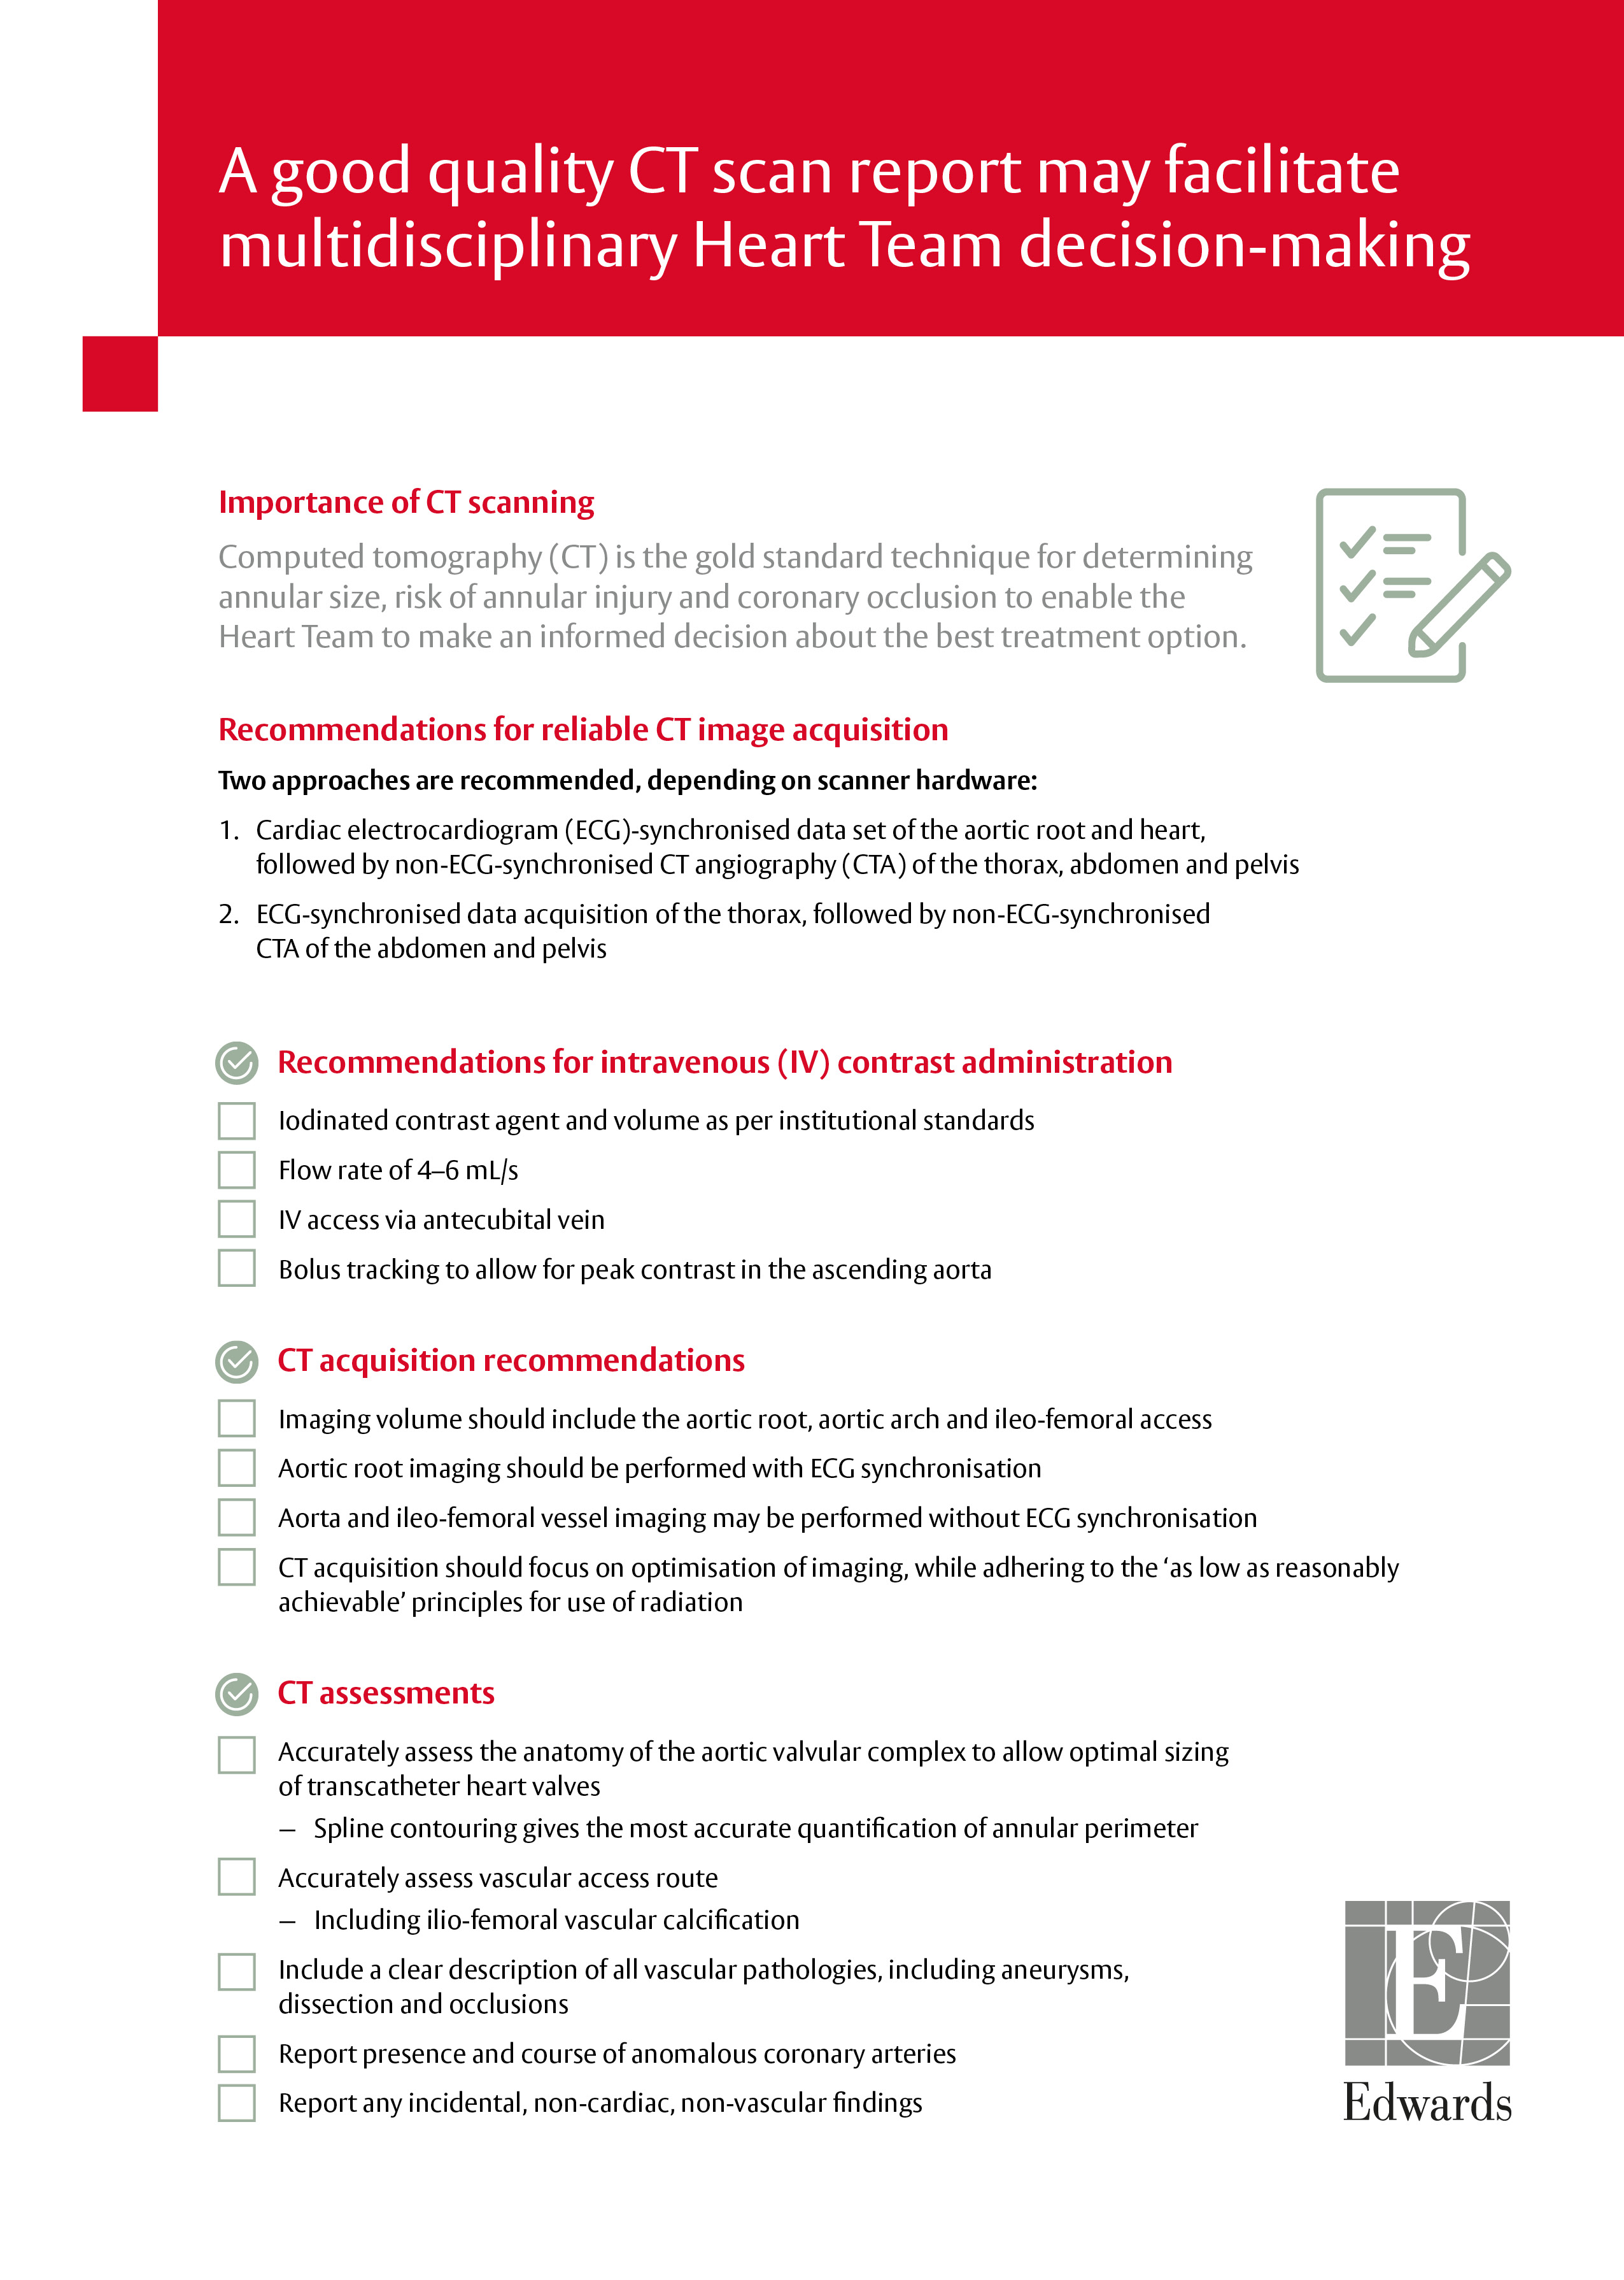
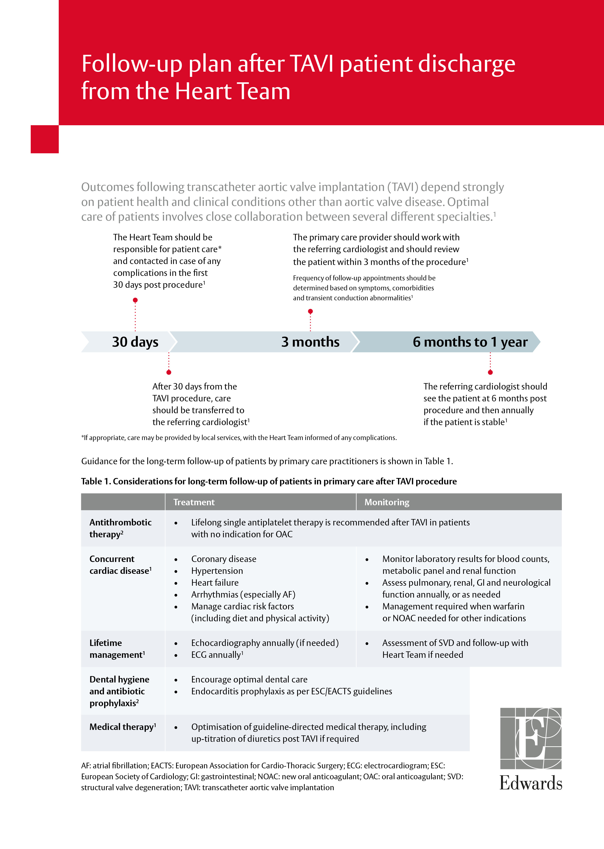


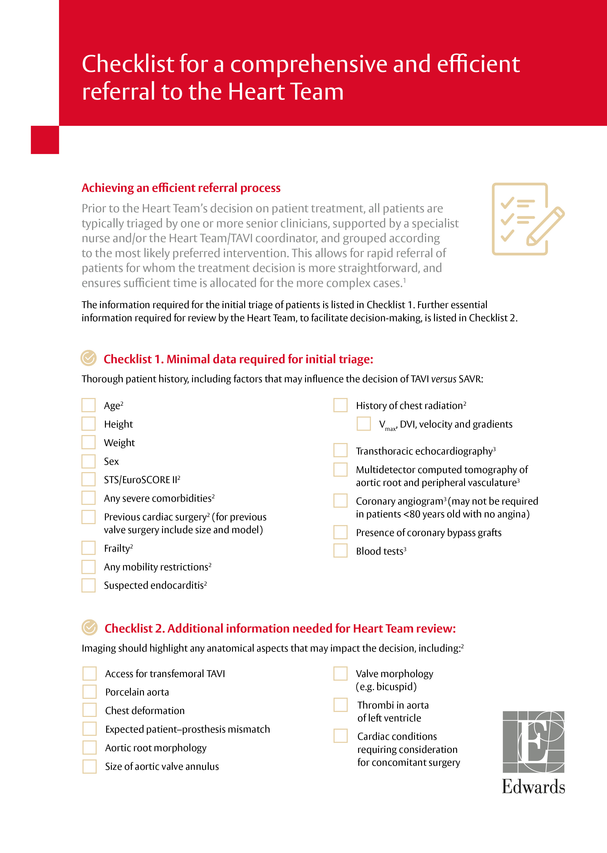
Checklists have been developed to support regular communication with referring physicians
Best practice 10: Regular communication with referring physicians and program administration
Pre-procedure
Post-procedure
Checklist for a comprehensive and efficient referral to the Heart Team
Checklist for a
good-quality
CT scan report
Follow-up plan after
TAVI patient discharge
from the Heart Team
To aid efficient triage by ensuring referral letter includes dataset required
for MDM, and ensure continuity of care^{1–3}
To ensure supply of essential data that inform procedural choices⁴
To help coordinate follow-up efforts
and ensure optimal
long-term patient outcomes⁵
Developed from European publications and guidelines
and reviewed by European program faculties
CT: computed tomography; MDM: mutidisciplinary meeting; TAVI: transcatheter aortic valve implantation.
1. Eskeland SL et al. Int J Qual Health Care. 2018; 30: 450–6; 2. Hartveit M et al. BMC Health Serv Res. 2017; 17: 4;
3. Archbold A et al. Heart. 2022; 108: e2;
4. Chopra M et al. BMC Cardiovasc Disord. 2018; 18: 231; 5. Otto CM et al. J Am Coll Cardiol. 2017; 69: 1313–46.
Notes:
Checklist help improve (…):
Eskeland 2018: 2A
Hartveit 2017: 2A
Precise information queries (…):
Archbold 2022: 2A, 7A
To ensure supply of essential CT data (…):
Chopra 2018: 3A

Slide 37








TAVI Nurse Leadership development – an initiative by the Edwards Benchmark Program
TAVI nurse leadership is an essential element in implementing the Edwards Benchmark program successfully
Information and recommendations on adopting best practices for nursing and coordination at all stages of the TAVI clinical pathway in 7 modules:*
TAVI in modern day
Focus on peri-procedural care
A call for nursing leadership†
Focus on post-procedural care
7
modules
The TAVI assessment pathway
Optimising communication and change management
Patient education strategies and discharge planning
*Course format: Presentations, group discussions and self-test quizzes; †Part 1: The role of the TAVI Nurse Coordinator, Part 2: A culture of champions.
TAVI: transcatheter aortic valve implantation.
Edwards Benchmark Program

Slide 38
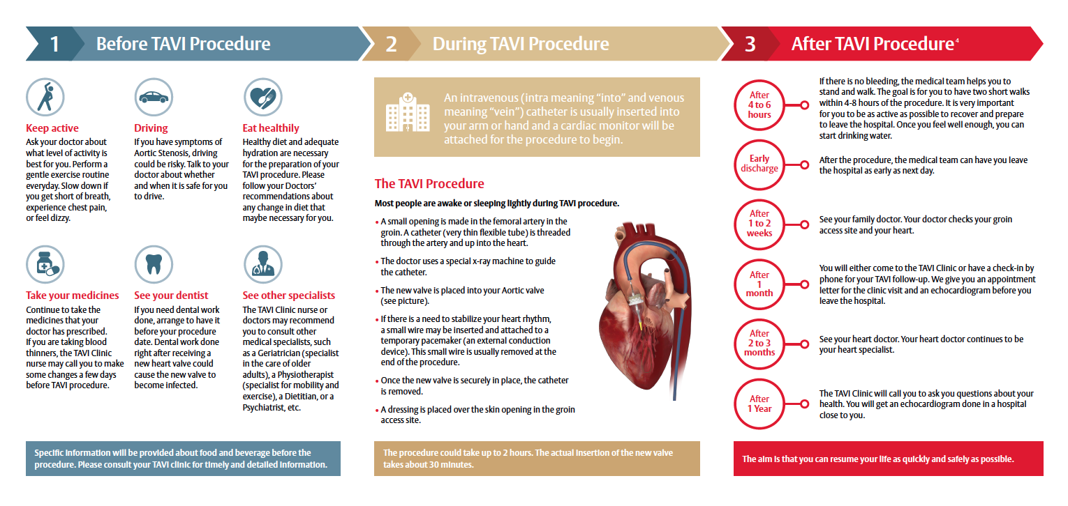





Patient education leaflet to support tailored education for patients and families by a member of the Heart Team
Best practice 3: Tailored education for patients and families that includes shared decision-making and discussion
of post-procedure discharge plan
Available in several languages
German
Spanish
Created in collaboration
with European faculties
English – Europe
Italian
French – France
French – Switzerland

Slide 39
Criteria to success and program status in Europe
Edwards Benchmark Program

Slide 40




Our global experience implementing the
Edwards Benchmark Program has uncovered key criteria that lead to success
Significant TAVI experience
Strong multidisciplinary team engagement
Receptive to learning from experts, and modify existing practices
TAVI: transcatheter aortic valve implantation.
Edwards Benchmark Program

Slide 41
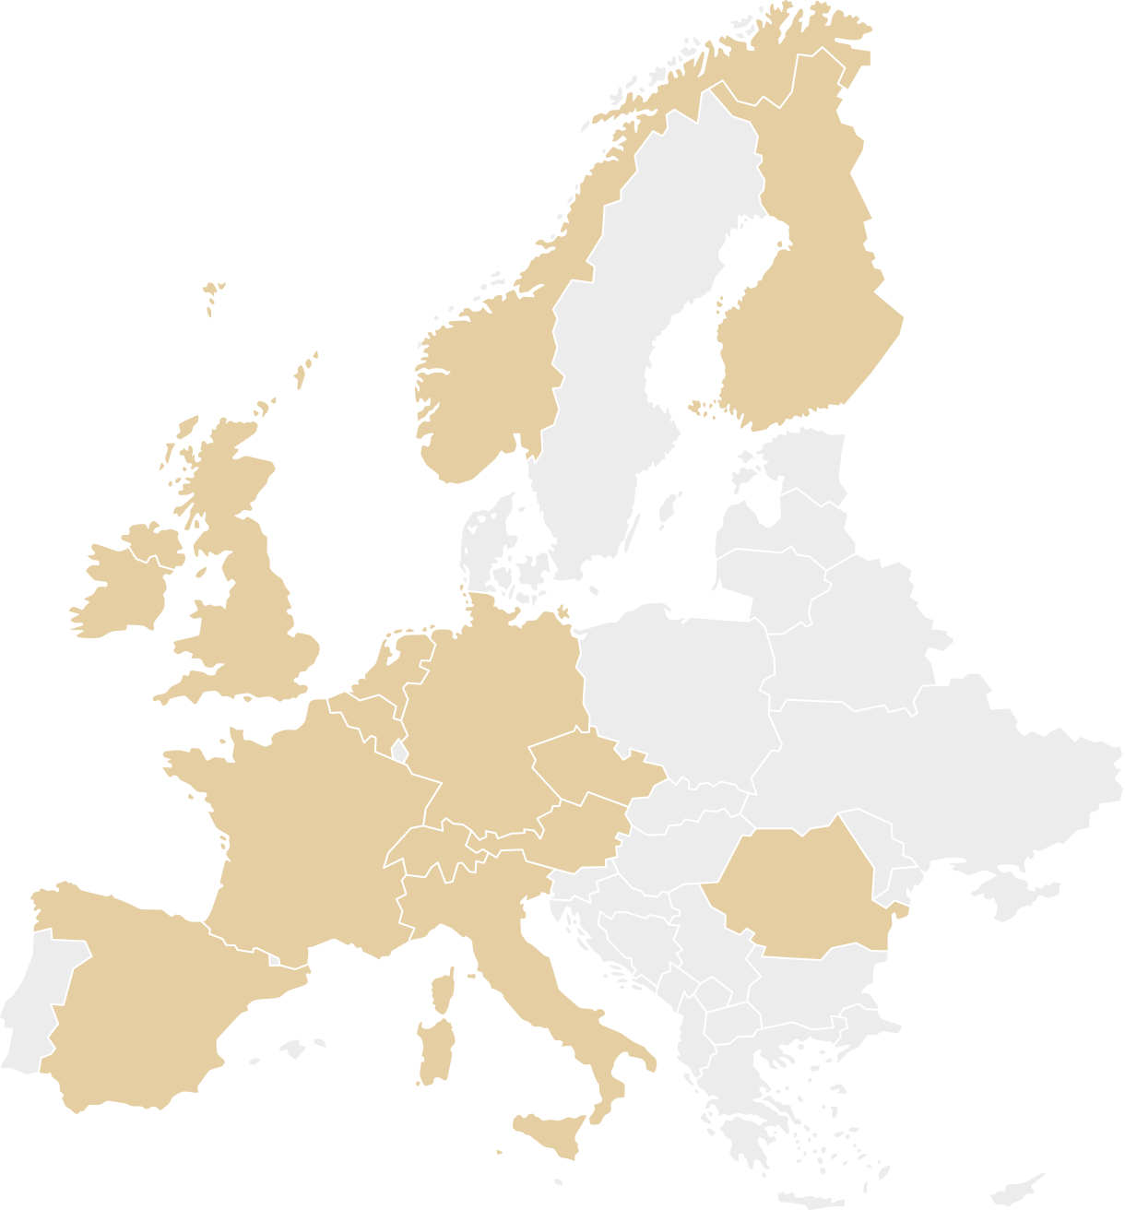
Join an expanding network of centres across Europe leading the way towards an optimised TAVI care pathway
In Europe today, the Edwards Benchmark program community comprises of over 25 faculty centres, over 85 certified centres and over 60 active centres
TAVI: transcatheter aortic valve implantation.

Slide 42
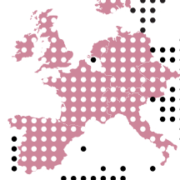


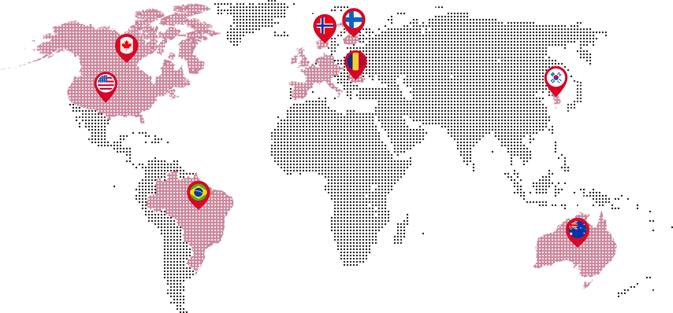







Join us on the journey to better clinical outcomes for patients with severe aortic stenosis
Best practices are now available to multidisciplinary Heart Teams worldwide through the Edwards Benchmark program
Learn from other Edwards Benchmark program centres and strive to obtain the best outcomes for all patients
  Bringing together the TAVI community worldwide in pursuit
  of a common goal: the best outcomes for patients
TAVI: transcatheter aortic valve implantation.

Slide 43

Edwards
Benchmark Program
Transcatheter Valve Care Pathway
Sign up to receive latest updates
from the Edwards Benchmark program.
Don’t miss out –
scan the code to sign up now!

Slide 44
Edwards, Edwards Lifesciences, the stylized E logo, and Edwards Benchmark are trademarks or service marks of Edwards Lifesciences Corporation or its affiliates. All other trademarks are the property of their respective owners.
© 2023 Edwards Lifesciences Corporation. All rights reserved. NP--EU-1482 v5.0
Edwards Lifesciences • Route de l’Etraz 70, 1260 Nyon, Switzerland • edwards.com

